Slide 1
Data Science BootCamp: Module 1
Ridge & Lasso (Day 2)
February 20, 2018
Prasun Biswas
Rituparno Guha

Slide 2
Situations where OLS does not give best results
Skewed distribution of the target variable
Too many predictor variables
(High Dimensional Data leading to Multicollinearity)
Y
X1 X2 ………………………………………………………………. X1000
The OLS model we build on this data will not work well to predict the target values which lie in the tail end of the above distribution.
The regression will predict best for the modal values (near 0’s)
Problem of Bias in the Estimation
Variable selection in the above model will be difficult because there will be many competing models when the variables are too many.
Multicollinearity leads to high variance in the beta coefficients
Problem of High Variance in the Betas

Slide 3
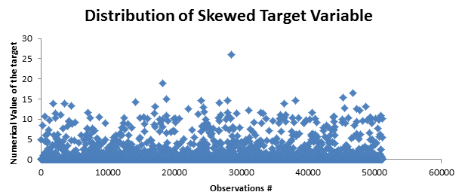
What is Bias in Estimation?
Theorem: MSE of OLS model = Error due to Bias + Error due to Variance
If we build a model to predict a skewed target using an unbiased sample then the regression line will predict the modal values as below and give the least MSE
But the regression will not predict accurately the extreme values.
However if we take a Biased sample from the data then the overall mean squared error will increase
But the regression will actually do well to predict the extreme values
This is desirable when there is a need to predict the extreme values more accurately than the model values. E.g. Insurance claim $ prediction

Slide 4
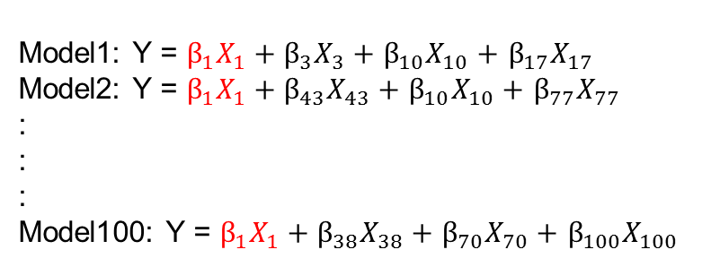
What is Variance in Estimation ?
Theorem: MSE of OLS model = Error due to Bias + Error due to Variance
High Dimensional Data
Leads to multiple possible models
Y
X1 X2 ………………………………………… X1000
Model1: Y = $β_{1}X_{1}+β_{3}X_{3}+$ $β_{10}X_{10}+$ $β_{17}X_{17}$
Model2: Y = $β_{1}X_{1}+β_{43}X_{43}+$ $β_{10}X_{10}+$ $β_{77}X_{77}$
:
:
:
Model100: Y = $β_{1}X_{1}+β_{38}X_{38}+$ $β_{70}X_{70}+$ $β_{100}X_{100}$
Good Fit – Low Variance of Beta – Low MSE
Poor Fit – High Variance of Beta – High MSE
Distribution of β₁
Notice the variance in β₁
Model # | β₁
1 | 1.5
2 | 0.3
3 | 3.2
4 | 0.4
5 | 6.8
Y
σ
X₁
X₁
μ

Slide 5
Bias Variance Tradeoff
In Supervised machine learning or advanced analytics an algorithm/model learns from training data
The goal of any algorithm is to best estimate the mapping function(f) for the output variable(Y), given the input data (X). The prediction error for any machine learning algorithm can be broken down into three parts:
Bias Error
Variance Error
Irreducible Error
The irreducible error cannot be reduced regardless of what algorithm is used. It is the error introduced from the chosen framing of the problem and may be caused by factors like unknown variables that influence the mapping of the input variables to the output variable
Bias Error
Bias are the simplifying assumptions made by a model to make the target function easier to learn.
Generally, parametric algorithms have a high bias, making them fast to learn and easier to understand but generally less flexible. In turn, they have lower predictive performance on complex problems that fail to meet the simplifying assumptions of the algorithms bias.
Low Bias: Suggests less assumptions about the form of the target function.
High-Bias: Suggests more assumptions about the form of the target function.
Variance Error
Variance is the amount that the estimate of the target function will change if different training data was used.
Ideally, variance should not change too much from one training dataset to the next, meaning that the algorithm is good at picking out the hidden underlying mapping between the inputs and the output variables.
Generally, nonparametric machine learning algorithms that have a lot of flexibility have a high variance. For example, decision trees have a high variance, that is even higher if the trees are not pruned before use.
Low Variance: Suggests small changes to the estimate with changes to the training dataset.
High Variance: Suggests large changes to the estimate with changes to the training dataset.

Slide 6
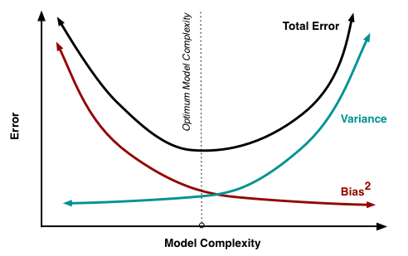
Bias Variance Tradeoff
High-bias & low-variance algorithms include: Linear Regression, Linear Discriminant Analysis and Logistic Regression. (may have high error due to the fact that linear model could not approximate underlying data well)
.
High-variance & low-bias algorithms include: Decision Trees, k-Nearest Neighbors, Support Vector Machines. (in which even a small change in training data may cause significant change in the fit due to complexity)
Graphical Representation of Bias-variance
(center of the target is a model that perfectly predicts the correct values)
Bias and variance are inversely related to each other.
As the model complexity increases variance increases and bias decreases.
-------- Hence need a good fit by balancing both.

Slide 7
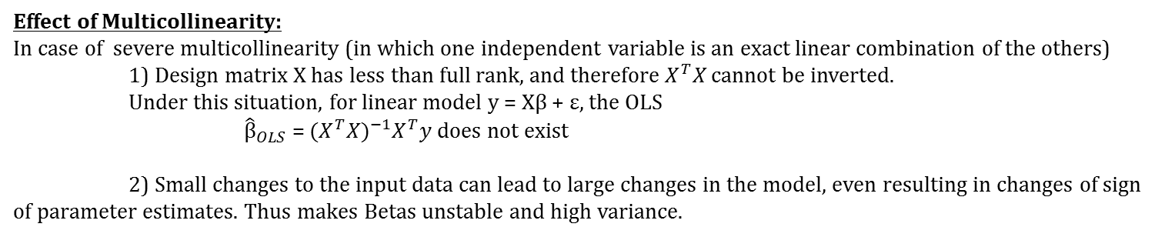
Multicollinearity Effect & Regularization
Effect of Multicollinearity:
In case of severe multicollinearity (in which one independent variable is an exact linear combination of the others)
1) Design matrix X has less than full rank, and therefore $X^{T}X$ cannot be inverted.
Under this situation, for linear model y = Xβ + ε, the OLS
${\hat{β}}_{OLS}$ = ${{(X}^{T}X)}^{−1}X^{T}y$ does not exist
2) Small changes to the input data can lead to large changes in the model, even resulting in changes of sign of parameter estimates. Thus makes Betas unstable and high variance.
Regularization:
The fundamental goal of any algorithm is to generalize beyond the training sets. Hence, Regularization in simple terms is a process of introducing additional information in order to solve an ill posed problem or to prevent overfitting.
Ex:
Suppose we want to predict the salary. We took sample from 10 different cities asking respondents their age, sex, level of education, profession and years of experience, profession of parents, weight, height, best food among others. It becomes more complex. And our model can now generalize and make good prediction of our training data.
But can it make good prediction of other test set it has not seen. No, because it will always stick to the data as it has memorized the data.
-----This is what we call overfitting. Our model has a high variance and that’s what regularization wants to solve.
We want to penalize or adjust each weights of the independent variables so that it makes a good prediction on test set that it has not seen before. In other words , we say regularization performs feature selection by shrinking the contribution of each features. Regularization is used in machine learning techniques like Gradient boosting, Light GBM, Random forest etc.
This ideal goal of generalization in terms of bias and variance is a low bias and a low variance which is near impossible or difficult to achieve. Hence, the need of the trade-off.

Slide 8
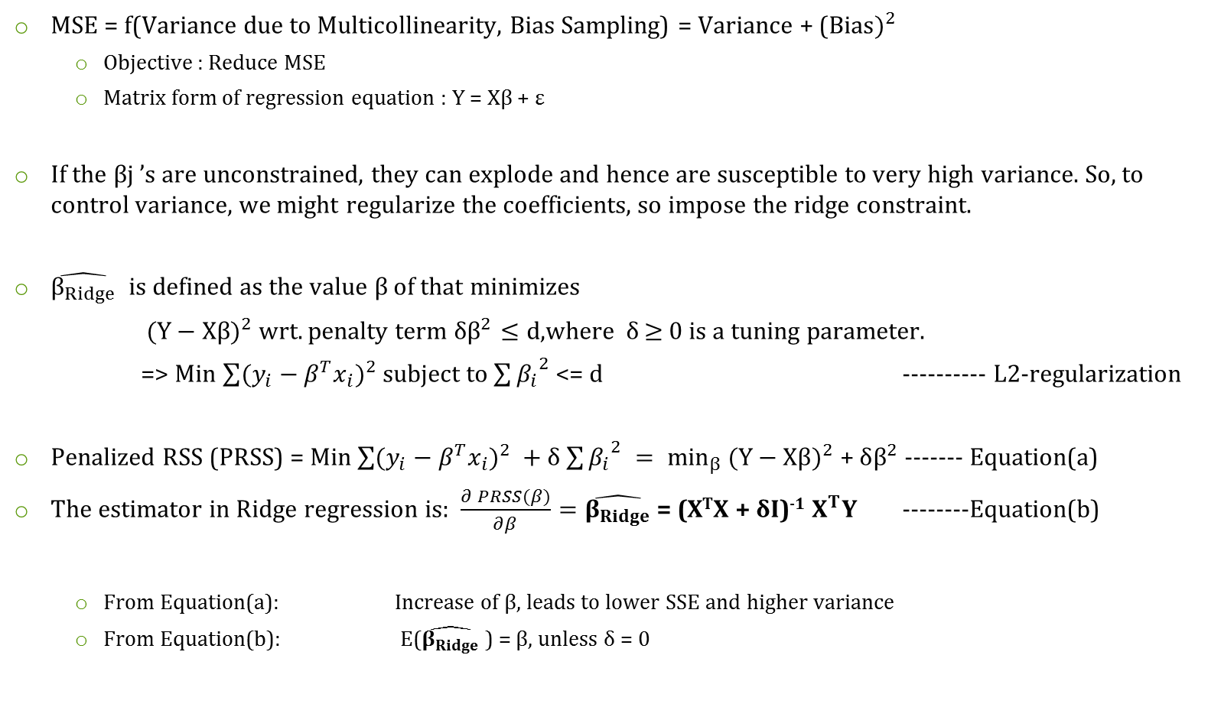
Ridge Regression and Ridge Estimate
MSE = f(Variance due to Multicollinearity, Bias Sampling) = Variance + (${Bias)}^{2}$
Objective : Reduce MSE
Matrix form of regression equation : Y = Xβ + ε
If the βj ’s are unconstrained, they can explode and hence are susceptible to very high variance. So, to control variance, we might regularize the coefficients, so impose the ridge constraint.
$\hat{β_{Ridge}}$ is defined as the value $β$ of that minimizes
${(Y−Xβ)}^{2}$ wrt. penalty term $δβ^{2}≤d$,where δ$≥$ 0 is a tuning parameter.
=> Min $\sum{{(y_{i}−β^{T}x_{i})}^{2} }$subject to $\sum{{β_{i}}^{2} }$<= d ---------- L2-regularization
Penalized RSS (PRSS) = Min $\sum{{(y_{i}−β^{T}x_{i})}^{2} }+$ δ $\sum{{β_{i}}^{2} }{= min}_{β}$ ${(Y−Xβ)}^{2}$ + $δβ^{2}$ ------- Equation(a)
The estimator in Ridge regression is: $\frac{∂ PRSS(β)}{∂β}=\hat{β_{Ridge}}$ = (X^{T}X + δI)⁻¹ $X^{T}Y$ --------Equation(b)
From Equation(a): Increase of β, leads to lower SSE and higher variance
From Equation(b): E($\hat{β_{Ridge}}$ ) = β, unless δ = 0

Slide 9



Geometric interpretation of Ridge Estimate
${(Y−Xβ)}^{2}$ = $Y^{2}+X^{2}β^{2}−2βXY$ : Equation of an Ellipse
$β^{2}≤d$ : General Equation of a Circle
We try to minimize the ellipse size and circle simultaneously.
Trade-off: Maybe a large β would give a better RSS but it will push the penalty term higher ---- So we prefer smaller β's with worse residual sum of squares.
$$β_{2}$$
OLS Estimate
The ellipses correspond to the contours of residual sum of squares (RSS). The inner ellipse has smaller RSS, and RSS is minimized at OLS estimates.
$$β_{1}$$
Ridge Estimate

Slide 10
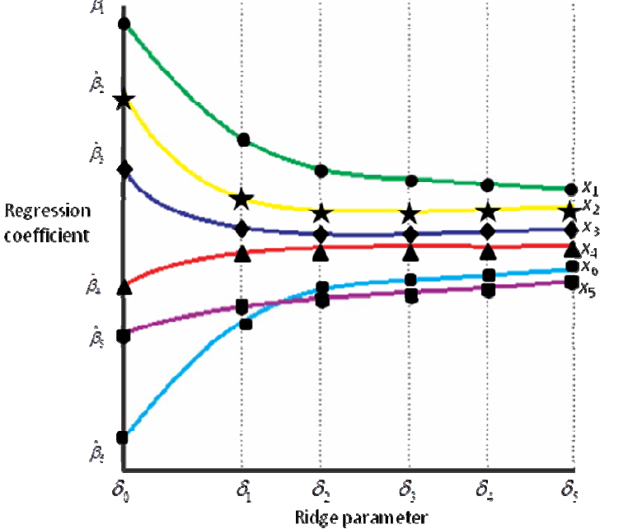
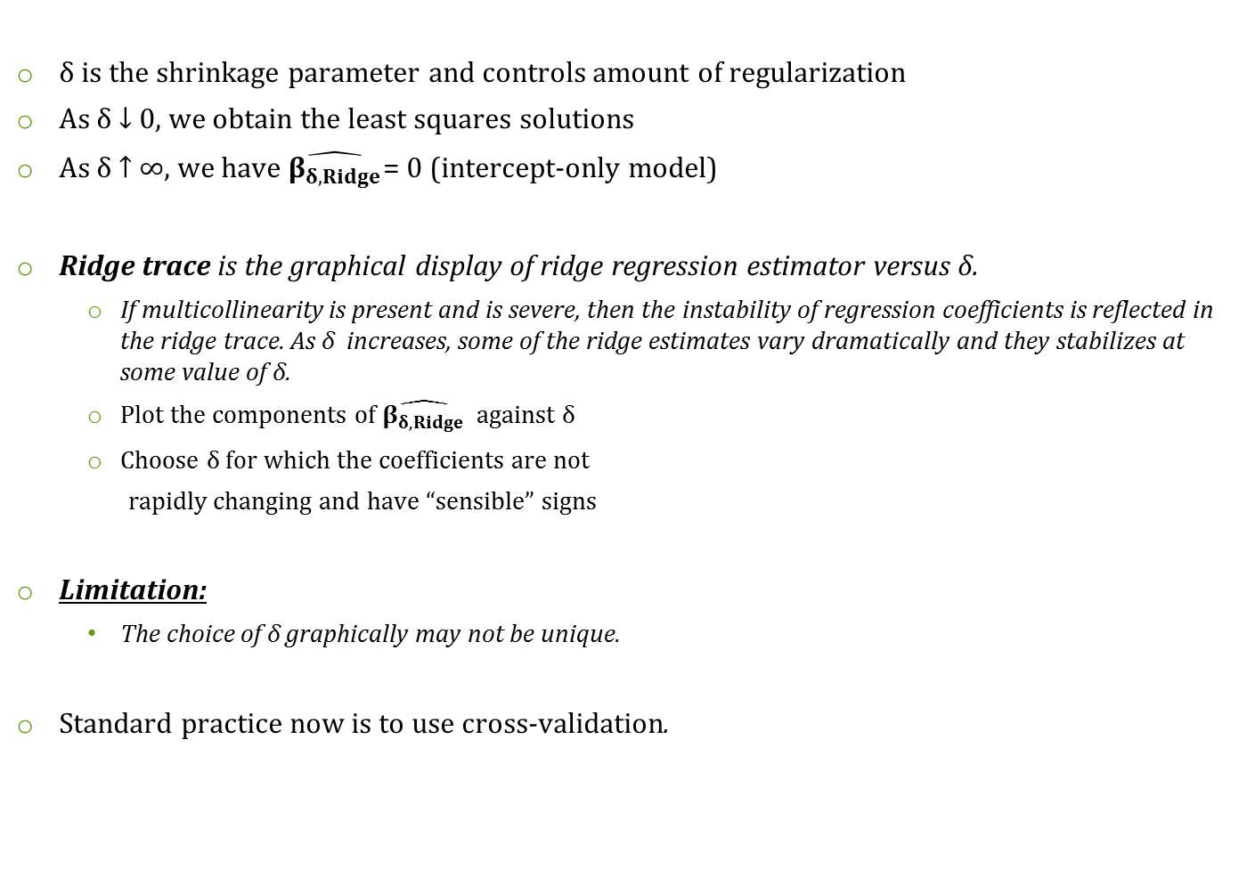
Choice of δ : Ridge Trace
δ is the shrinkage parameter and controls amount of regularization
As δ ↓ 0, we obtain the least squares solutions
As δ ↑ ∞, we have $\hat{β_{δ,Ridge}}$= 0 (intercept-only model)
Ridge trace is the graphical display of ridge regression estimator versus δ.
If multicollinearity is present and is severe, then the instability of regression coefficients is reflected in the ridge trace. As δ increases, some of the ridge estimates vary dramatically and they stabilizes at some value of δ.
Plot the components of $\hat{β_{δ,Ridge}}$ against δ
Choose δ for which the coefficients are not
rapidly changing and have “sensible” signs
Limitation:
The choice of δ graphically may not be unique.
Standard practice now is to use cross-validation.

Slide 11
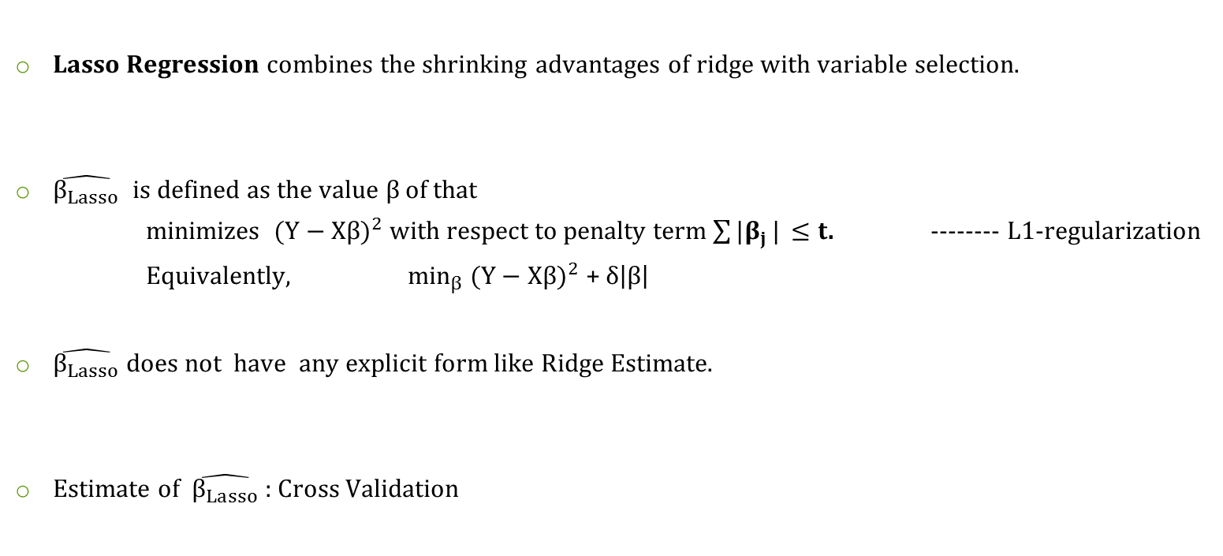
Lasso Regression
Lasso Regression combines the shrinking advantages of ridge with variable selection.
$\hat{β_{Lasso}}$ is defined as the value $β$ of that
minimizes ${(Y−Xβ)}^{2}$ with respect to penalty term $\sum{|β_{j}}|$ $≤t$. -------- L1-regularization
Equivalently, $\min_{β}$ ${(Y−Xβ)}^{2}$ + $δ\left|β\right|$
$\hat{β_{Lasso}}$ does not have any explicit form like Ridge Estimate.
Estimate of $\hat{β_{Lasso}}$ : Cross Validation

Slide 12
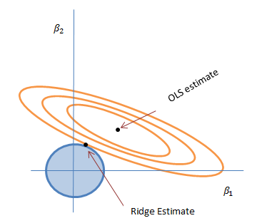
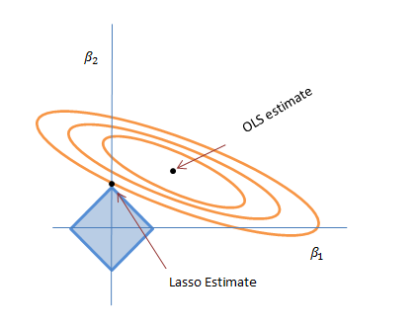
Why Lasso can do variable selection
We are trying to minimize the ellipse size and circle
(penalty term) simultaneously in the ridge regression.
We are trying to minimize the ellipse size and diamond
(penalty term) simultaneously in the lasso regression.
Lasso can result in a model where some parameters can be exactly zero, while Ridge can lead to parameters with very small value but not exactly zero.
Hence, Lasso can be used for Feature selection.

Slide 13
Spline Regression (Piecewise)

Slide 14
Case where linear regression seems a difficult idea..

Slide 15
Introduction to curve fitting – Roughness Penalty Approach
Aims of curving fitting
A good fit to the data
To obtain a curve estimate that does not display too much rapid fluctuation
Basic idea: making a necessary compromise between the two rather different aims in curve estimation
Quantifying the roughness of a curve
An intuitive way:
(g: a twice-differentiable curve)
Motivation from a formalization of a mechanical device: if a thin piece of flexible wood, called a spline, is bent to the shape of the graph g, then the leading term in the strain energy is proportional to

Slide 16
Roughness Penalty Approach (2)
Penalized sum of squares
where g is any twice-differentiable function on [a,b] and
is smoothing parameter (‘rate of exchange’ between residual error
and local variation)
Penalized least squares estimator
Curve for a large value of
Curve for a small value of
Notes:
The main component in S(g) will be roughness penalty term and hence minimizer g_hat will display very little curvature. In the limiting case as alpha tends to infinity the penalty term will be forced to zero and the curve g_hat will approach the linear regression line.
The main component in S(g) will be residual SS, and the curve estimate g_hat will track the data closely

Slide 17
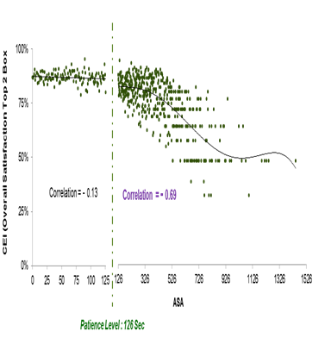
Cubic Splines
Given a<t₁<t₂<…<t_{n}<b, a function g is a cubic spline if
On each interval (a,t₁), (t₁,t₂), …, (t_{n},b), g is a cubic polynomial
The polynomial pieces fit together at points t_{i} (called knots) s.t. g itself and its first and second derivatives are continuous at each t_{i}, and hence on the whole [a,b]
How to specify a cubic spline
Choosing the smoothing parameter can be subjective. Also, more statistically speaking, the smoothing parameter can be obtained by cross- validation.
Example:
There is a significant negative correlation between Average Seconds To Answer and Customer Experience Index Top 2 Box after 126 secs. So In this case, spline can be used.

Slide 18
Thank You!

